Slide 1
CS 2212
Introduction to Software Engineering
Chapter 1 Key Principles – Software Life Cycle - Process

Slide 2
Copyright Notice This Presentation and Its Associated Video Contain Copyright Material. This Presentation and Its Associated Video Are Provided for Teaching Purposes of CS2212 and Should Not Be Posted In Any External Site, Or Shared with. This Presentation and Its Associated Video Are Provided For Instructional Personal Use Only, and Only For The Purposes of the CS2212 Course.

Slide 3
Part 6
Software Process Modeling Concepts
You can mass-produce hardware; you cannot mass-produce software; you cannot mass-produce the human mind.
— Michio Kaku
Notes:
This lesson introduces the basic steps in a software engineering project at a high level.
In practice, steps often overlap.

Slide 4
Learning Objectives in this Part
To understand what a software process is (slides 4-6)
To understand the foundational guiding principles behind applying a software process (slides 7-11)

Slide 5
Software Engineering: A Process-centric Discipline
Specifying, developing, testing, and maintaining software systems of high quality is an engineering activity
It requires the application of a process, and the use of methods, techniques and tools

Slide 6
What Is a Software Engineering Process?
A process defines Who is doing What, When and How in the development of a software system
Roles and workflows
Workproducts
Milestones
Guideline
…
New or changed
requirements
Software Engineering
Process
New or changed
system
Notes:
It can be very difficult to explain what a process is, if people aren’t already familiar with it. An informal example most people can relate to is the process of balancing a checkbook at the end of the month. Most of us have developed a process we use - the same steps every month. It shortens the time required to accomplish the task and ensures that we don’t forget any steps. The same applies to a software engineering process. We want it to be repeatable and ensure that all required tasks are accomplished when required. Of course, a software engineering process is much more complex than balancing a checkbook and there is a tremendous amount of information contained in the RUP.

Slide 7
Lightweight vs. Heavyweight Processes
Heavyweight
e.g., V-Process
Customizable
Framework
e.g., Rational
Unified
Process (RUP)
Agile (Lightweight)
e.g., eXtreme
Programming (XP)
Document driven
Elaborate workflow definitions
Many different roles
Many checkpoints
High management overhead
Highly bureaucratic
Focus on working code
rather than documentation
Focus on direct communication
(between developers and
between developers and the customer)
Low management overhead

Slide 8
Principles that Guide Process
Principle #1. Be agile. Whether the process model you choose is prescriptive or agile, the basic tenets of agile development should govern your approach (we will talk more on agility later).
Principle #2. Focus on quality at every step. The exit condition for every process activity, action, and task should focus on the quality of the work product that has been produced.
Principle #3. Be ready to adapt. Process is not a religious experience and dogma has no place in it. When necessary, adapt your approach to constraints imposed by the problem, the people, and the project itself.

Slide 9
Principles that Guide Process
Principle #4. Build an effective team. Software engineering process and practice are important, but the bottom line is people. Build a self-organizing team that has mutual trust and respect.
Principle #5. Establish mechanisms for communication and coordination. Projects fail because important information falls through the cracks and/or stakeholders fail to coordinate their efforts to create a successful end product.

Slide 10
Principles that Guide Process
Principle #6. Manage change. The approach may be either formal or informal, but mechanisms must be established to manage the way changes are requested, assessed, approved and implemented.
Principle #7. Assess risk. Lots of things can go wrong as software is being developed. It’s essential that you establish contingency plans.
Principle #8. Create work products that provide value for others. Create only those work products that provide value for other process activities, actions or tasks.

Slide 11
Reuse
A good software design solves a specific problem but is general enough to address future problems (for example, changing requirements)
Experts do not solve every problem from first principles
They reuse solutions that have worked for them in the past
Goal for the software engineer:
Design the software to be reusable across application domains and designs
How?
Use design patterns and frameworks whenever possible

Slide 12
Design Patterns and Frameworks
Design Pattern:
A small set of classes that provide a template solution to a recurring design problem
Reusable design knowledge on a higher level than data structures (link lists, binary trees, etc.)
Framework:
A moderately large set of classes that collaborate to carry out a set of responsibilities in an application domain.
Examples: User Interface Builder
Provide architectural guidance during the design phase
Provide a foundation for software components industry

Slide 13
Your Turn
Why do we need to establish a software process before a software project commences?
List and briefly discuss three common risks in software projects.
What are the main characteristics of Agile processes?
Read the content of the following sites:
https://thescalers.com/risks-in-software-development-projects/
https://en.wikipedia.org/wiki/Change_management_(engineering)
https://www.drdobbs.com/software-change-management/184415707
https://en.wikipedia.org/wiki/Agile_software_development

Slide 14
Part 7
Software Process Modeling Facets
You can mass-produce hardware; you cannot mass-produce software; you cannot mass-produce the human mind.
— Michio Kaku
Notes:
This lesson introduces the basic steps in a software engineering project at a high level.
In practice, steps often overlap.

Slide 15
Learning Objectives in this Part
To learn about the basic development strategies and the software process activities

Slide 16
Three Facets to Consider Process
The Overall Development Strategy
Incremental
Evolutionary
The Structure (i.e. Flow) of Process Activities
Linear
Iterative
Evolutionary
Parallel
The specific Process Model Selected and Applied
Waterfall
Spiral
RUP
XP
Scrum
….

Slide 17
Process Modeling Facets
Overall Development
Strategy
Process Activity
Flow Structure
Project-X: <Incremental Strategy,
Parallel Flow,
Unified Process Model>
Evolutionary
Parallel
Evolutionary
Incremental
Iterative
Linear
Process Model
Used
Spiral
Waterfall
XP
Scrum
Unified Process

Slide 18
Facet 1: Overall Development Strategy
(i.e. how overall development proceeds)

Slide 19
Incremental Development Strategy
By applying a selected process model e.g. Waterfall or SCRUM
Release 1
R1-R10
Deployment
Release 2
Requirements R1-R20
R11-R13
Deployment
Release 3
R14-R20
Deployment
Each release adds more functionality, i.e., a new increment, but all come from a fixed set of agreed requirements

Slide 20
Evolutionary Development Strategy
By applying a selected process model e.g. Waterfall or SCRUM
Version 1
Requirements
Deployment
Version 2
Requirements
Deployment
Version 3
Feedback
Requirements
Deployment
New versions implement new and evolving requirements

Slide 21
Facet 2: Process Activity Flow Structure
(i.e. how Process Activities are organised)

Slide 22
Process Activity Flows
There are five key flows applicable to all software projects:
Communication
Planning
Modeling
Construction
Deployment

Slide 23
Process Activity Flows
There are five key activity areas applicable to all software projects:
Communication
Planning
Modeling
Construction
Deployment
(i.e. Release)
Before technical work can commence, it is important to communicate and collaborate with customers and other stakeholders to understand their objectives and to identify what they need and want as outcomes. Relates
more to the Analysis and Requirements phases of the
Software Life cycle.

Slide 24
Process Activity Flows
There are five key activities applicable to all software projects:
Communication
Planning
Modeling
Construction
Deployment
(i.e. Release)
Software projects are complex journeys and so planning is required to create a “map” to guide the team along this journey. This plan describes the technical tasks to be conducted, the risks that are likely, the resources that will be required, the work products to be produced, and a work schedule. Relates to the Analysis,
Requirements, and Design phases of the
Software Life cycle.

Slide 25
Process Activity Flows
There are five key activities applicable to all software projects:
Communication
Planning
Modeling
Construction
Deployment
(i.e. Release)
To better understand the problem and how it is going to be solved, a software engineer creates models of the software’s requirements and the design that will achieve those requirements. Relates to the
Requirements, Design and Testing phases of the
Software Life cycle.

Slide 26
Process Activity Flows
There are five key activities applicable to all software projects:
Communication
Planning
Modeling
Construction
Deployment
(i.e. Release)
What is designed must be built. Construction entails both code generation (either manual or automated) as well as the testing required to uncover errors in the code. Relates to the Design, Implementation,
and Testing phases of the Software Life cycle.

Slide 27
Process Activity Flows
There are five key activities applicable to all software projects:
Communication
Planning
Modeling
Construction
Deployment
(i.e. Release)
The software is delivered to the customer who evaluates the delivered product, provides feedback based on the evaluation, and (assuming everything is acceptable) puts the software into use. Relates mostly
to the Requirements and Testing phases of the
Software Life cycle.

Slide 28
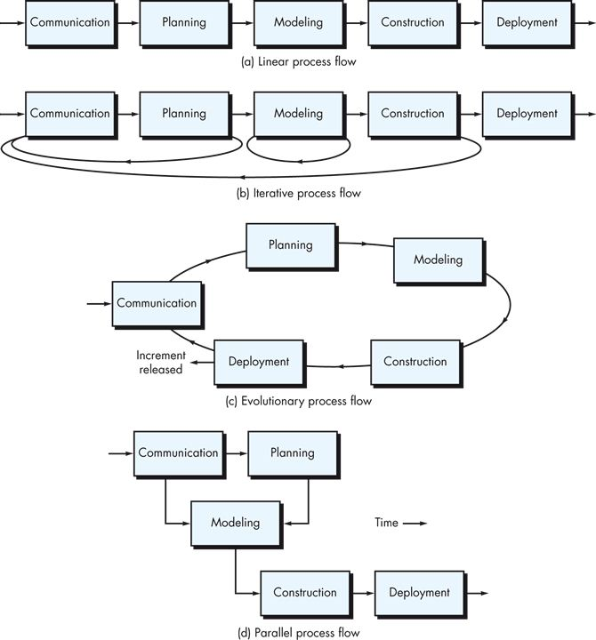
Linear Process Activity Flow
Each of the process activities are executed in sequence.
Fits very well with the waterfall model.

Slide 29
Iterative Process Activity Flow
One or more of the activities are repeated before proceeding to the next.
Fits well with the Spiral model and the Unified Process model

Slide 30
Evolutionary Process Activity Flow
Activities are executed in a “circular” manner, with each circuit leading to a more complete version of the software.
Fits well with the SCRUM or Extreme Programming model

Slide 31
Parallel Process Activity Flow
One or more activities are executed in parallel with other activities (for example, modeling for one aspect might be executed at the same time that another aspect is under construction).
Fits well with the Unified Process model.

Slide 32
Umbrella Activity Flows
Software project tracking and control.
Risk management.
Software quality assurance.
Technical reviews.
Measurement.
Software configuration management.
Reusability management.
Work product preparation and production.

Slide 33
Facet 3: Process Model Used
(i.e. how the Software Life Cycle unfolds during software development)

Slide 34
Process Models
A specific Process Model defines the particular process to be followed. We will see more examples of detailed process models next week. Examples are:
The Modern Process Models
The Unified Process Model (UP)
The Extreme Programming Process Model (XP)
The Scrum Process Model
The Legacy Process Models (or prescriptive models)
The Waterfall Process Model
The Spiral Process Model
For example the Waterfall Process model is Linear (with respect to flow), the Spiral Process model is Iterative, the Scrum Process model can be thought of as Evolutionary, while the Unified Process as Parallel.

Slide 35
An Outline of Legacy (Prescriptive Process Models)

Slide 36
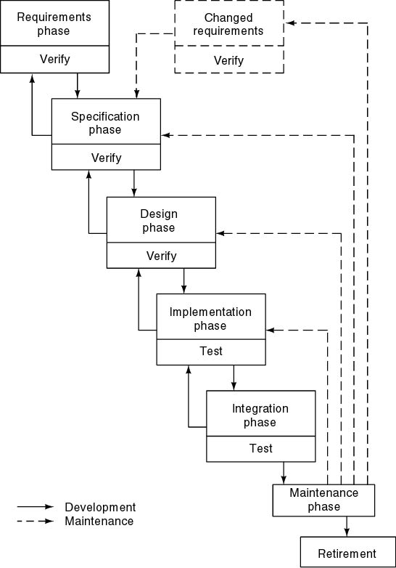
Waterfall Model
Characterized by
Sequential steps (phases)
Feedback loops (between two phases in development)
Documentation-driven
Advantages
Documentation
Maintenance easier
Disadvantages
Complete and frozen specification document up-front often not feasible in practice
Customer involvement in the first phase only
Sequential and complete execution of phases often not desirable
Process difficult to control
The product becomes available very late in the process

Slide 37
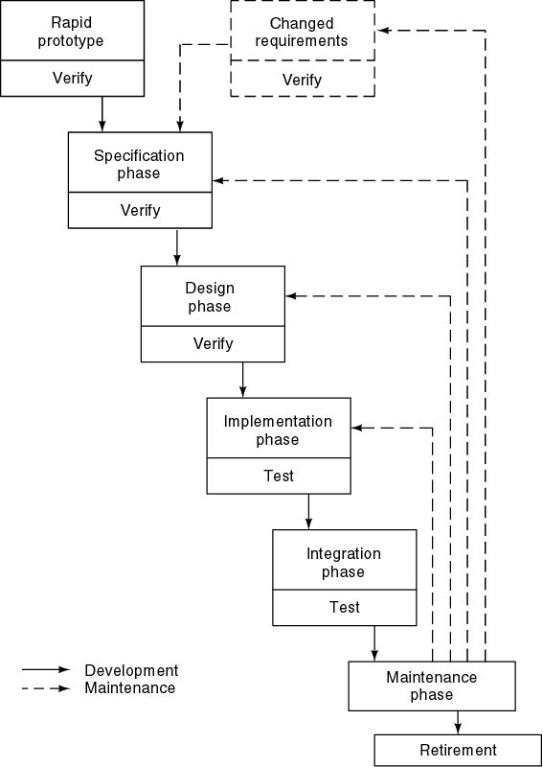
Rapid Prototyping Model
Rapid prototyping phase followed by waterfall
Do not turn the rapid prototype into the product
Rapid prototyping may replace the specification phase—never the design phase
Comparison:
Waterfall model—try to get it right the first time
Rapid prototyping—frequent change, then discard

Slide 38
Advantages and Disadvantages of Rapid Prototyping Model
Advantages
Requirements better specified and validated
Early feasibility analysis
Strong involvement of the customer in the prototyping phase
Disadvantage
Higher development effort
Danger that due to schedule slip, the prototype becomes part of the product

Slide 39
Spiral model
Waterfall model plus risk analysis preceding each phase and evaluation following each phase
Prototyping for high-risk specifications
Radial dimension: cumulative cost to date
Angular dimension: progress through the spiral
If all risks cannot be resolved, the project is immediately terminated
Appropriate only for big projects (high management overhead)

Slide 40
Spiral model

Slide 41
Hybrid process models
Large systems are usually made up of several sub-systems
The same process model need not be used for all subsystems
Prototyping for high-risk specifications
Waterfall model for well-understood developments
Taylor the process to a problem

Slide 42
Process Model Risk Problems
Waterfall
High risk for new systems because of specification and design problems
Low risk for well-understood developments using familiar technology
Prototyping
Low risk for new applications because specification and program stay in step
High risk because of additional resources required
Evolutionary and Spiral
Middle ground between waterfall and prototyping
Modern Software Engineering practices advocate the use of Agile Processes. Prescriptive models do not constitute the first choice anymore

